Slide 1


Deploying Custom LLMs with vLLM
PYCON AFRICA 2026 · PART 1 OF 2
How vLLM serves many users on one GPU, and a self-paced path to serverless deployment.
Patrick Walukagga
Software Engineer, Sunbird AI

Slide 2



Sunbird AI
ABOUT US
We build AI tools for African languages, from Kampala. Scan a code to try the products we serve in production.
Sunflower
API
Speech
Our language model for Ugandan languages
Translation, speech and language endpoints
Speech-to-text and text-to-speech
sunflower.sunbird.ai
speech.sunbird.ai
api.sunbird.ai
Deploying Custom LLMs with vLLM · PyCon Africa 2026
2

Slide 3
One talk, two parts
THE PLAN
PART 1 · TODAY, 30 MINUTES
PART 2 · SELF-PACED ON GITHUB
vLLM and how it works
Serverless deployment
What serving an LLM actually means
Why the KV cache is the real bottleneck
PagedAttention and continuous batching
Eight live demos on a 135M-parameter model
Packaging a custom model for vLLM
Serverless GPU endpoints that scale to zero
Cold starts, cost and monitoring
The same lab code, ready to run
github.com/PatrickCmd/
llm-deployment-vllm-serveless
Deploying Custom LLMs with vLLM · PyCon Africa 2026
3

Slide 4





What is LLM serving?
FOUNDATIONS
Running a model so that many people can send requests and get replies at the same time. A serving engine sits between the users and the GPU.
Users
Serving engine
GPU
Replies
Many requests arrive at once
Holds the model weights and the KV cache
Streamed back token by token
Queues, batches and schedules the work
GPUs are expensive. Every hour of idle compute costs money.
GPU memory is limited. Weights take most of it; requests share the rest.
Wasted memory means fewer users served per GPU, at a higher cost each.
Deploying Custom LLMs with vLLM · PyCon Africa 2026
4

Slide 5
Prefill, decode and the KV cache
FOUNDATIONS
STEP 1
STEP 2
STEP 3
Tokens
Prefill
Decode
The model splits text into tokens, roughly word pieces.
Reads the whole prompt once before writing anything.
Writes the reply one token at a time, each step reading everything before it.
The KV cache
one entry per token, kept for the life of the request
■ prompt tokens (prefill)
■ generated tokens (decode)
□ still to come, size unknown in advance
Without the cache every new token would recompute all the earlier work. With it, memory grows with every token of every active request.
Deploying Custom LLMs with vLLM · PyCon Africa 2026
5

Slide 6
The baseline: plain HuggingFace inference
DEMO · TASK 1
Load SmolLM-135M with transformers, generate 50 tokens, and time it. No batching, no scheduler: one request at a time.
$ python task_1_hf_baseline.py
Task 1: Naive HuggingFace Inference - The Baseline
python task_1_hf_baseline.py
Model: HuggingFaceTB/SmolLM-135M
Loading model with HuggingFace transformers...
Generating with HuggingFace transformers...
--- RESULTS ---
Generated tokens: 50
Total time: 0.74 seconds
67.1
Tokens per second: 67.1 tok/s
KEY INSIGHT: single-request performance.
Under load, requests would queue up.
tokens per second, serving exactly one user
Deploying Custom LLMs with vLLM · PyCon Africa 2026
6

Slide 7
What is vLLM?
THE ENGINE
An open-source, high-throughput serving engine for LLMs. It does not change the model's answers. It stops wasting GPU memory and time, so one GPU serves more users.
IDEA 1
IDEA 2
PagedAttention
Continuous batching
Manages the KV cache in small blocks, like an operating system pages memory.
Swaps finished requests for waiting ones at every decode step, so no GPU slot idles.
OTHER INFERENCE ENGINES YOU WILL MEET
SGLang
TensorRT-LLM
Text Generation Inference
llama.cpp and Ollama
Radix-tree prefix sharing, fast structured output
NVIDIA's compiled kernels, peak speed on NVIDIA GPUs
Quantized models on laptops and CPUs
Hugging Face's server, tight Hub integration
Deploying Custom LLMs with vLLM · PyCon Africa 2026
7

Slide 8
Same model, same prompt, served by vLLM
DEMO · TASK 2
Swap the transformers loop for vLLM's engine. Nothing else changes: same weights, same 50 tokens, same CPU.
$ python task_2_vllm_inference.py
Initializing vLLM engine...
python task_2_vllm_inference.py
vLLM engine ready.
--- COMPARISON: HuggingFace vs vLLM ---
Metric HuggingFace vLLM
Tokens/sec 67.1 87.9
Total time 0.74s 0.57s
vLLM is 1.3x faster in tokens/sec
67.1
87.9
A modest win for one user. The real advantage shows up when many users arrive at once. First, why.
HuggingFace tok/s
vLLM tok/s, 1.3x faster
Deploying Custom LLMs with vLLM · PyCon Africa 2026
8

Slide 9
The KV cache eats GPU memory
THE PROBLEM
A naive engine reserves one contiguous block per request, sized for the longest possible answer. Most answers are short, so most of the reservation sits empty.
Request A
50 of 2,000 slots used
Request B
600 of 2,000 slots used
Request C
180 of 2,000 slots used
Request D
no room left, must wait
Over-reservation
Fragmentation
The real bottleneck
Memory reserved but never used, and unavailable to anyone else.
Free memory split into gaps too small and scattered to fit a new request.
Memory management, not math speed, limits how many users a GPU serves.
Deploying Custom LLMs with vLLM · PyCon Africa 2026
9

Slide 10
Five requests, 512 slots reserved each
DEMO · TASK 3
python task_3_kv_cache_problem.py
79.7%
Short question
45 / 512
Medium paragraph
128 / 512
of the allocated memory is wasted
Quick greeting
23 / 512
2,560 slots allocated, 519 used
Long document
256 / 512
Code snippet
67 / 512
19 vs 97 users
Amber is memory in use. Grey is reserved and idle.
served from 10,000 slots: contiguous reservation versus no waste at all
Deploying Custom LLMs with vLLM · PyCon Africa 2026
10

Slide 11
PagedAttention: the KV cache in small blocks
THE CORE IDEA
PHYSICAL BLOCKS, 16 TOKENS EACH
BLOCK TABLE
Request A
3 → 7 → 1 → 12
Request B
0 → 5 → 18
Request C
9 → 21
Each request's blocks in order. They need not be adjacent in memory.
■ Request A
■ Request B
■ Request C
□ free pool, any block fits any request
Allocate on demand. A request takes one more block only when it needs one.
Return on finish. Freed blocks go straight back to the pool for the next request.
Borrowed from the OS. Virtual memory paging, applied to attention.
Deploying Custom LLMs with vLLM · PyCon Africa 2026
11

Slide 12
The same five requests, in 16-token pages
DEMO · TASK 4
python task_4_paged_attention.py
4.7x
Method | Allocated | Used | Utilization
Contiguous | 2,560 slots | 519 slots | 20.3%
Paged | 544 slots | 519 slots | 95.4%
less memory for the same work
Request 1: 45 tokens → 3 pages (48 slots) waste 6.2%
19 → 92 users
Request 2: 128 tokens → 8 pages (128 slots) waste 0.0%
Request 3: 23 tokens → 2 pages (32 slots) waste 28.1%
Request 4: 256 tokens → 16 pages (256 slots) waste 0.0%
Request 5: 67 tokens → 5 pages (80 slots) waste 16.2%
from the same 10,000 slots, with utilization up from 20% to 95%
The only waste left is the tail of each request's last page.
Deploying Custom LLMs with vLLM · PyCon Africa 2026
12

Slide 13
Blocks can be shared, not copied
A BONUS OF BLOCKS
Because the cache is made of blocks, two requests can point at the same ones. Identical beginnings are stored once.
Shared prefixes
Beam search and sampling
A long system prompt that every chat starts with lives in memory once. Each new conversation reuses those blocks and adds only its own.
Several candidate answers share their common beginning and only take new blocks where they diverge.
User 1
Beam 1
User 2
Beam 2
■ system prompt, stored once ■ ■ each user's own turns
■ shared beginning ■ ■ where the beams diverge
Deploying Custom LLMs with vLLM · PyCon Africa 2026
13

Slide 14
vLLM as an OpenAI-compatible server
DEMO · TASK 5
Start the server once. Any app that already speaks the OpenAI API points at it by changing one URL.
--- RESPONSE ---
vllm serve HuggingFaceTB/SmolLM-135M --port 8000
Model: HuggingFaceTB/SmolLM-135M
Latency: 0.56s
Prompt tokens: 7
# task_5_api_server.py
Completion tokens: 50
from openai import OpenAI
--- API DETAILS ---
Endpoint: /v1/completions
client = OpenAI(
Format: OpenAI-compatible
base_url="http://localhost:8000/v1",
api_key="not-needed",
)
Zero code changes for existing OpenAI SDK apps.
response = client.completions.create(
model="HuggingFaceTB/SmolLM-135M",
Chat, completions and embeddings endpoints out of the box.
prompt="What is inference in machine learning?",
max_tokens=50,
)
This is how you self-host an open or custom model in production.
Deploying Custom LLMs with vLLM · PyCon Africa 2026
14

Slide 15
Continuous batching keeps every slot busy
THE SECOND IDEA
Static batching
Continuous batching
The batch runs until its longest request finishes. Short requests leave their slots idle.
At every decode step, finished requests leave and waiting ones join. Freed blocks are reused immediately.
DECODE STEPS →
DECODE STEPS →
Four slots, four requests. Pale cells are idle GPU time while the queue waits.
Same four slots. New requests fill the gaps the moment a slot frees up.
Together with PagedAttention: a freed slot and its freed blocks are both back in play on the very next step.
Deploying Custom LLMs with vLLM · PyCon Africa 2026
15

Slide 16
Throughput grows with concurrent users
DEMO · TASK 6
python task_6_multi_user_load.py
4.0x
1, 5, 10 and 20 users each send one request of 50 tokens at the same moment. Aggregate tokens per second, all requests successful.
392.4
353.1
295.1
more tokens per second at 20 users than at 1, on one CPU
Per-request latency rises gently; total work done rises fast.
97.8
No queue code written. The engine batches on its own.
This is the core value of vLLM: many users per device.
1 user
5 users
10 users
20 users
0.51s latency
0.84s latency
1.41s latency
2.55s latency
Deploying Custom LLMs with vLLM · PyCon Africa 2026
16

Slide 17
Tuning the knobs for your workload
DEMO · TASK 7
python task_7_tuning.py
--max-model-len
Longest context per request. Lower means less KV cache per user, so more users fit.
Three server configurations, each benchmarked with 10 concurrent requests of 50 tokens.
Config | max_model_len | max_num_seqs | Throughput
A: Default | 128 | 256 | 316.6 tok/s
B: Shorter context | 64 | 256 | 323.9 tok/s
C: Limited concurrency | 64 | 8 | 279.9 tok/s
--max-num-seqs
How many sequences run in one batch. Trades per-request latency for total throughput.
--gpu-memory-utilization
Share of GPU memory vLLM may claim for weights plus KV cache blocks.
Config C has the lowest latency per request (1.38s) but the lowest total throughput. There is no single best setting.
Measure with your own prompts and traffic shape before you pick.
Deploying Custom LLMs with vLLM · PyCon Africa 2026
17

Slide 18
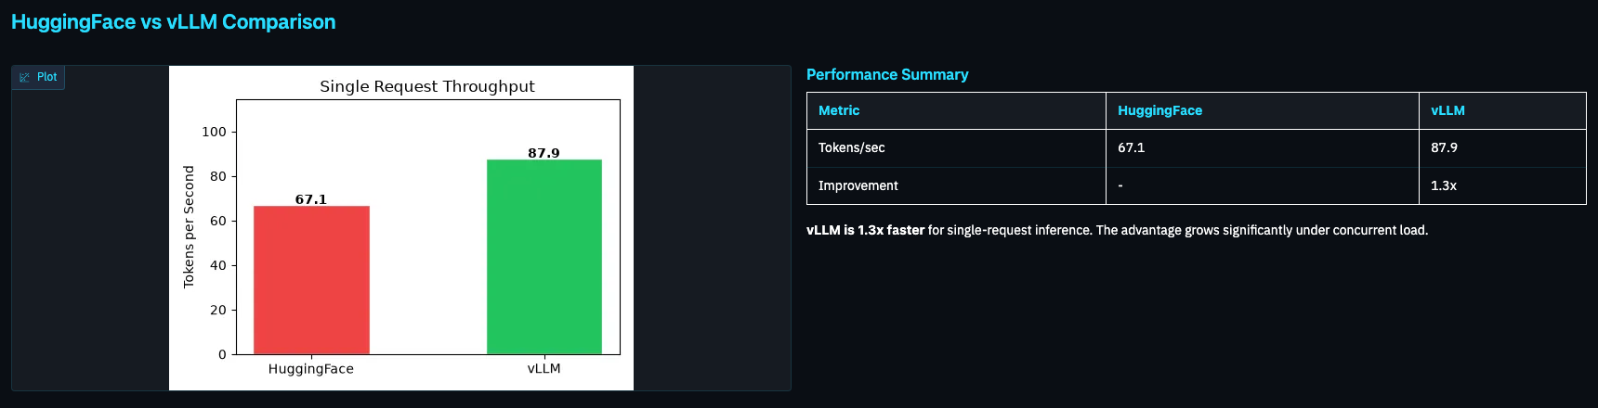
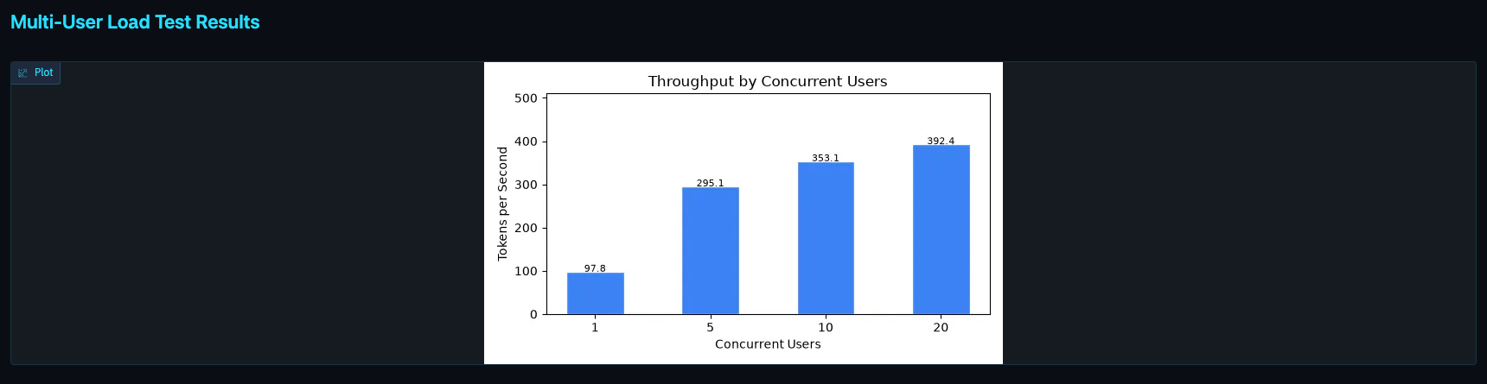
A monitoring dashboard for the running server
DEMO · TASK 8
python task_8_dashboard.py
A Gradio app on port 7860 that reads the results every task wrote and polls the live server.
Top panel: the same model served two ways. The gap is the engine, not the weights.
Bottom panel: continuous batching at work. Throughput climbs as users arrive.
Live row: a refresh button sends a real request and reports tokens per second and latency now.
Deploying Custom LLMs with vLLM · PyCon Africa 2026
18

Slide 19
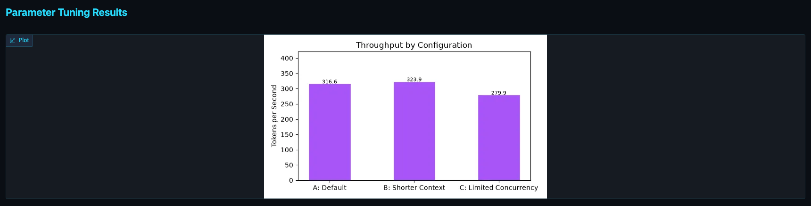
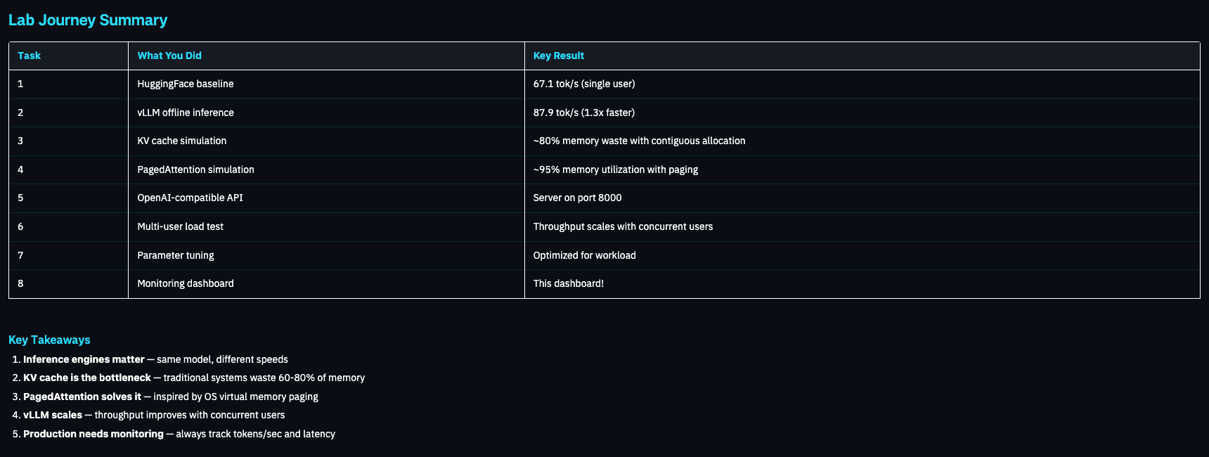
What production monitoring should always show
DEMO · TASK 8
Tuning panel: every configuration change, benchmarked before it ships.
Journey table: the eight tasks and their key results in one place.
Two numbers to keep on a screen for any LLM service:
Tokens per second
how much work the GPU is doing
Latency per request
what each user actually feels
Deploying Custom LLMs with vLLM · PyCon Africa 2026
19

Slide 20




Why teams reach for vLLM
RECAP
Higher throughput
Better GPU use
Lower cost per request
Drop-in API
4x more tokens per second at 20 users in our demo, far more on a real GPU.
KV cache utilization from about 20% to about 95%. Memory and compute both stay busy.
OpenAI-compatible endpoints mean no application rewrite.
More users per GPU is fewer GPUs for the same traffic.
WHERE IT SHINES
WHERE IT SHINES
High-traffic chat and translation
Agent systems
Continuous batching keeps slots full and PagedAttention fits many users' caches at once.
Long repeated instructions reuse shared prefix blocks. Many short steps batch together.
vLLM does not change the model's answers. It stops wasting memory and time.
Deploying Custom LLMs with vLLM · PyCon Africa 2026
20

Slide 21

Deploying it serverless
PART 2 · SELF-PACED
FOLLOW ALONG
Everything you saw today runs on a laptop CPU. The repository continues the story on GPU serverless infrastructure.
Package a custom or fine-tuned model for vLLM
Serve it from a serverless GPU endpoint that scales to zero
Handle cold starts, cost and monitoring
All eight lab tasks, ready to run
github.com/PatrickCmd/
llm-deployment-vllm-serveless
Star it, clone it, run verify_environment.py

Slide 22
Thank you
Questions now, or find me after the session.
Patrick Walukagga
Software Engineer, Sunbird AI
api.sunbird.ai · sunflower.sunbird.ai · speech.sunbird.ai

